Slide 1
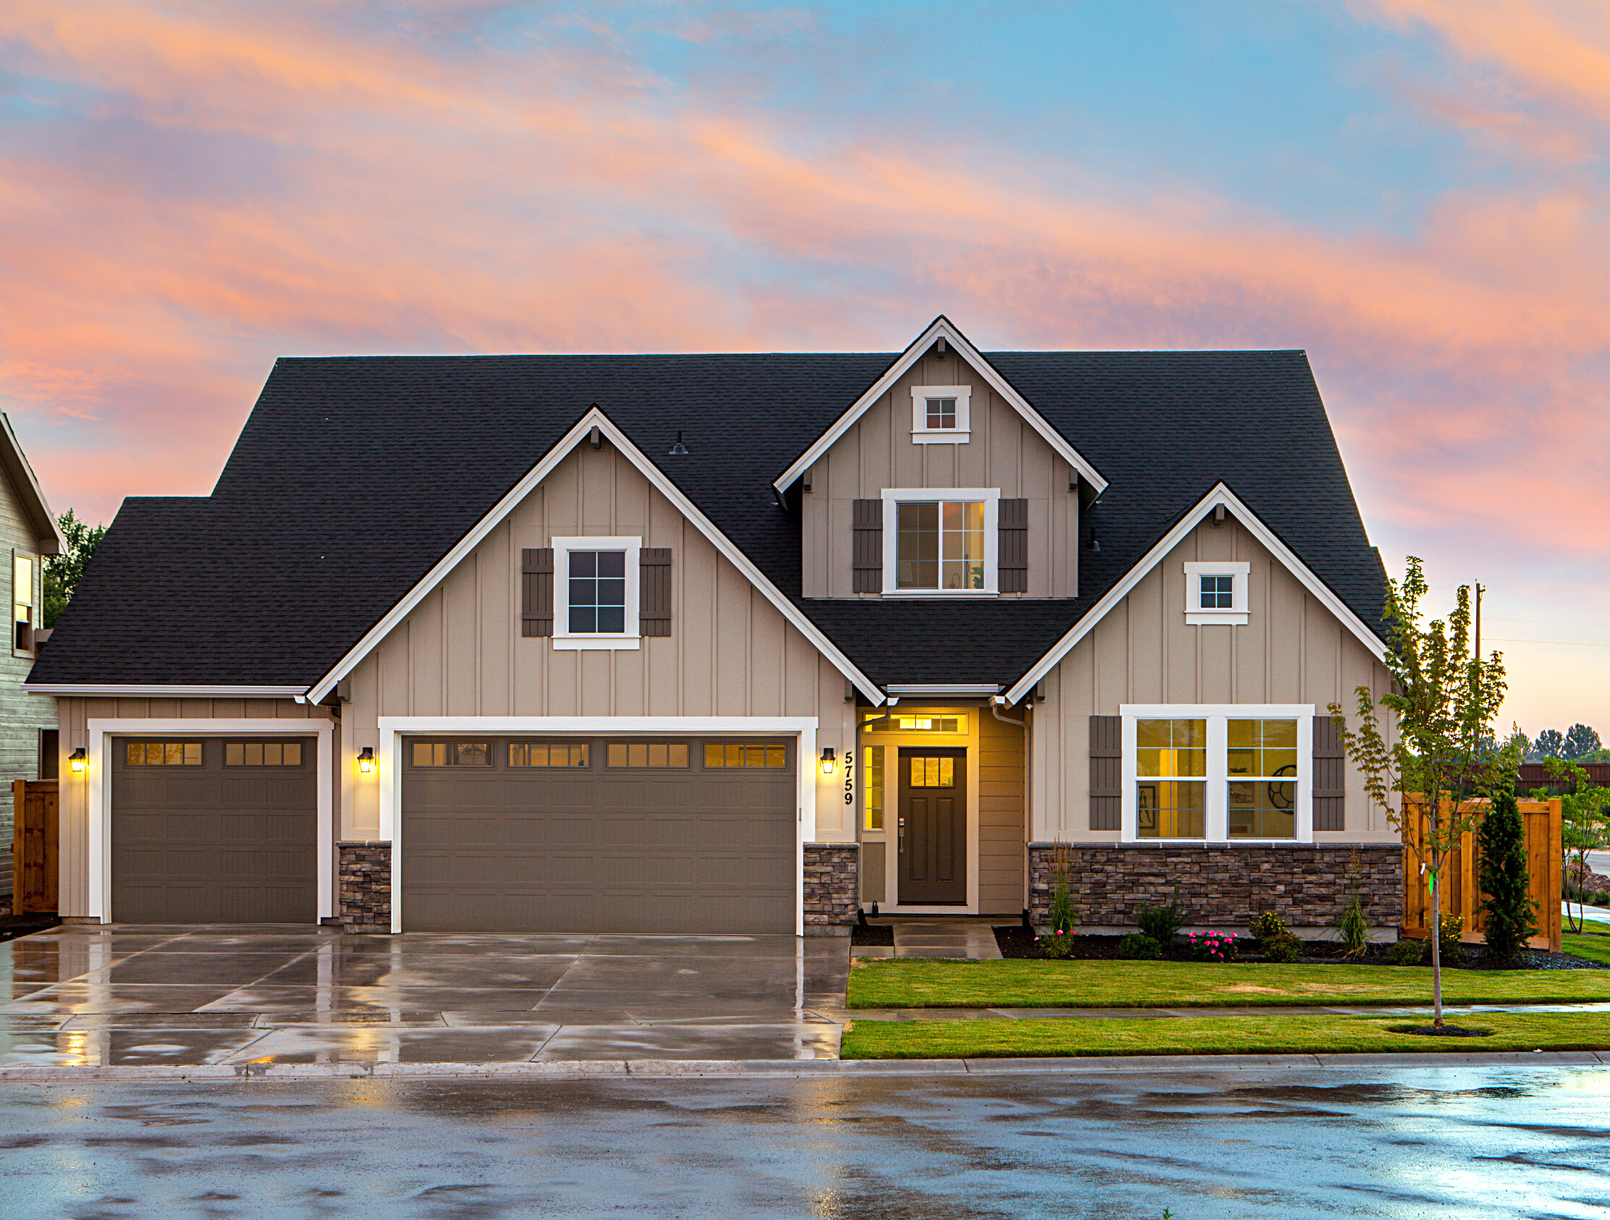
DATATRAINED EDUCATION
House Price Prediction Report
by Razni Nazeem
FLIPROBO TECHNOLOGIES

Slide 2

AGENDA
Overview.
Problem Statement.
Problem Understanding.
Housing Price Prediction and importance
Exploratory data analysis.
Visualizations.
Analysis.
Data cleaning steps.
Model Building.
Hyper Parameter Tunning.
Saving the model and predictions from saved best model.
Conclusion.
02–15

Slide 3

Overview
01
EXPLORATORY DATA ANALYSIS
Analyzing the dataset using exploratory data Analysis and Visualization
02
BUILDING THE MODEL
Building the model using the train dataset
03
PREDICTING THE HOUSE PRICE
Predicting the price of House for the Test dataset using the model built.
03–15

Slide 4
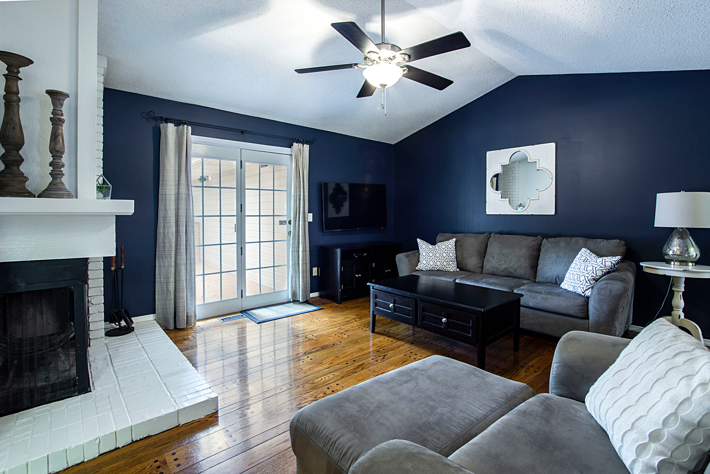
Problem Statement
A US-based housing company named Surprise Housing has decided to enter the Australian market. The company uses data analytics to purchase houses at a price below their actual values and flip them at a higher price. For the same purpose, the company has collected a data set from the sale of houses in Australia. The data is provided in the CSV file below.
The company is looking at prospective properties to buy houses to enter the market. You are required to build a model using Machine Learning in order to predict the actual value of the prospective properties and decide whether to invest in them or not. For this company wants to know:
• Which variables are important to predict the price of variable?
• How do these variables describe the price of the house?

Slide 5
Problem Understanding
Low inventory, fervid competition and massive price gains have battered buyers since 2020, but now rapidly rising mortgage rates are making it even harder to purchase an affordable home. Housing price trends are not only the concern of buyers and sellers, but it also indicates the current economic situation. Therefore, it is important to predict housing prices without bias to help both the buyers and sellers make their decisions. This project uses an open-source dataset, which include 81 explanatory features and 1,168 entries of housing sales in AMES, USA. The aim is to predict the efficient house pricing for real estate customers with respect to their budgets and priorities. By analyzing previous market trends and price ranges, and upcoming developments future prices will be predicted.

Slide 6


Housing Price Prediction and Its Importance
Data Science
Data science comes as a very important tool to solve problems and to help the companies increase their overall revenue, improving their marketing strategies and focusing on changing trends in house sales. The relationship between house prices and the economy is an important motivating factor for predicting house prices.
Importance
House Price prediction is important to drive Real Estate efficiency. As earlier, House prices were determined by calculating the acquiring and selling price in a locality. Therefore, the House Price prediction model is very essential in filling the information gap and improving Real Estate efficiency.
06–15

Slide 7
Exploratory Data Analysis
01
02
Imported Libraries and Loaded the dataset. Aldo did all the statistical Analysis of the dataset like shape, unique, value_counts, etc.
Dropped columns with 80% and more null values and value as Zero, as it might cause bias and variance while model building.
04
05
03
Dropped ID and Utilities columns which have all unique values.Extracted age of the house and garage from respective Year columns.
All the steps were done in both Train and Test Dataset
Replaced NaN values with mean, median and mode using Imputation Technique.

Slide 8
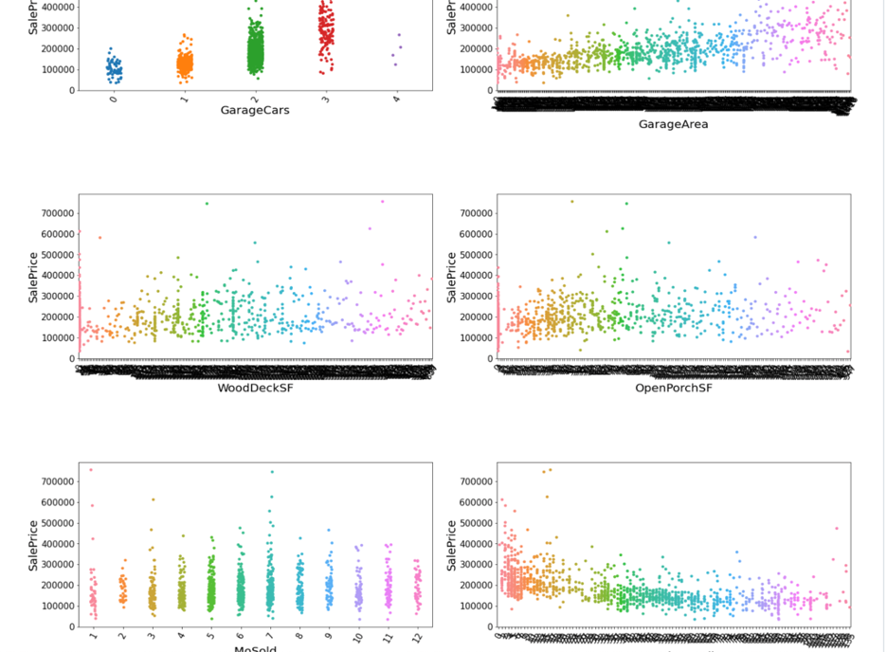
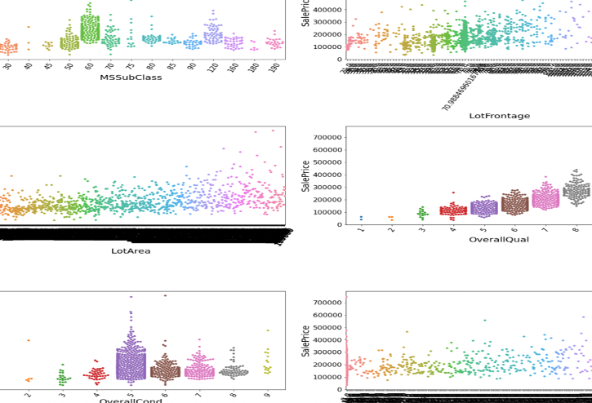
Visualization of Numerical columns
REAL ESTATE LISTING － JANUARY 2020

Slide 9
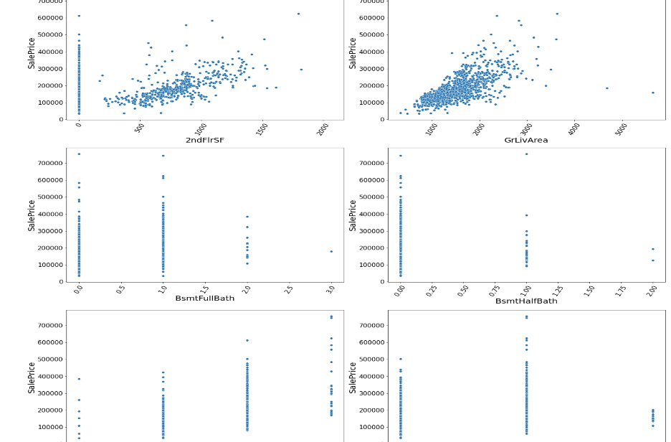
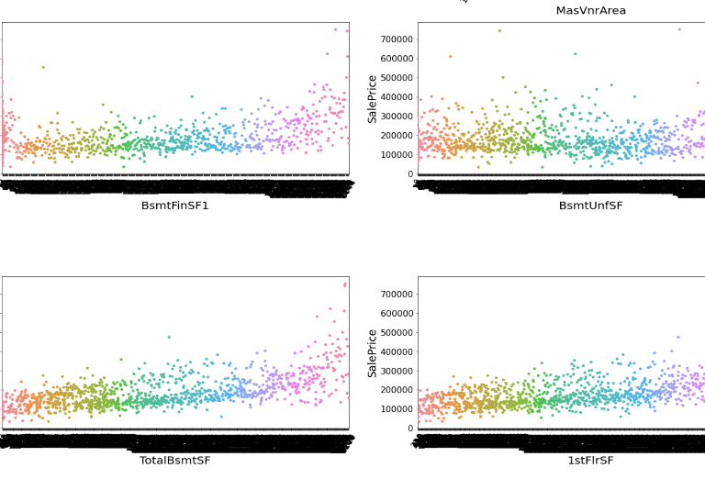
Visualization of Numerical columns
REAL ESTATE LISTING － JANUARY 2020

Slide 10
Observations:
For size of the garage upto 3 cars, the price increases.
Generally, as Area of the garage increases, the Price also increases.
There is no specific pattern for WoodDeckSF and OpenPorhSF.
As years have passed, the Price decreases.
As garage age increases, price decreases.
As the 2ndFlrSF increases price also increases.
As ground level area increases, Price Increases.
The price and demand is high for 0 and 1 full baths in the basement.
If full bath is 3 Price is higher than 0,1 or 2
For 4 bedrooms houses above ground level then price is higher.
Price is higher for 1 kitchen above ground level.
As total rooms above grade increase, the Price also increases.
Price is higher if there are 2 fireplaces.
MSSubClass- 2-STORY 1946 & NEWER and 1-STORY 1946 & NEWER ALL STYLES are having higher sale Price.
LotFrontage & LotArea- There is no specific pattern for Linear feet of street connected to property and Lot size in square feet.
OverallQual- As the overall quality of the material and finish of the house increases, Sale Price also increases.
OverallCond- Though the overall condition increases, Sale Price also increases, the Average rating houses are in more demand and Sale Price is higher.
MasVnrArea, BsmtFinsF1, BsmtUnfSF, TotalBsmtSF & 1stFlrSF have an increasing pattern with Price.
REAL ESTATE LISTING － JANUARY 2020

Slide 11
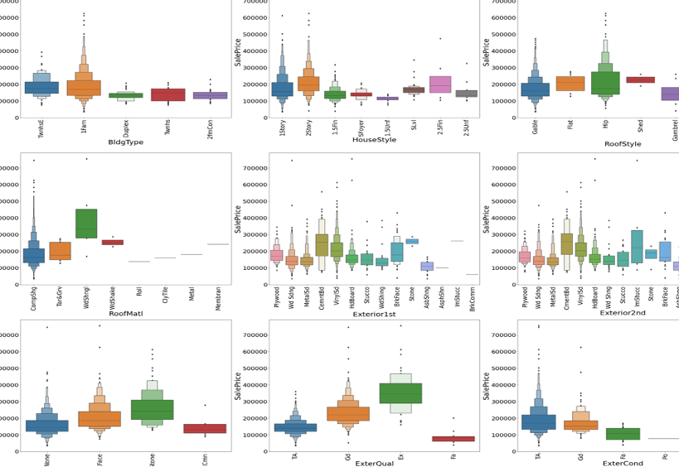
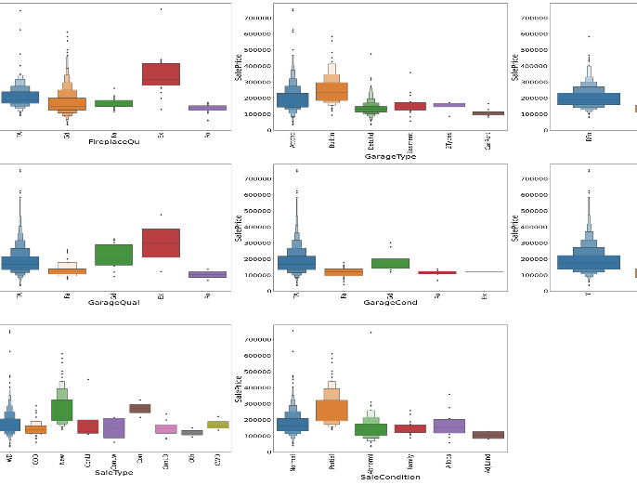
Visualization of Categorical columns
REAL ESTATE LISTING － JANUARY 2020

Slide 12
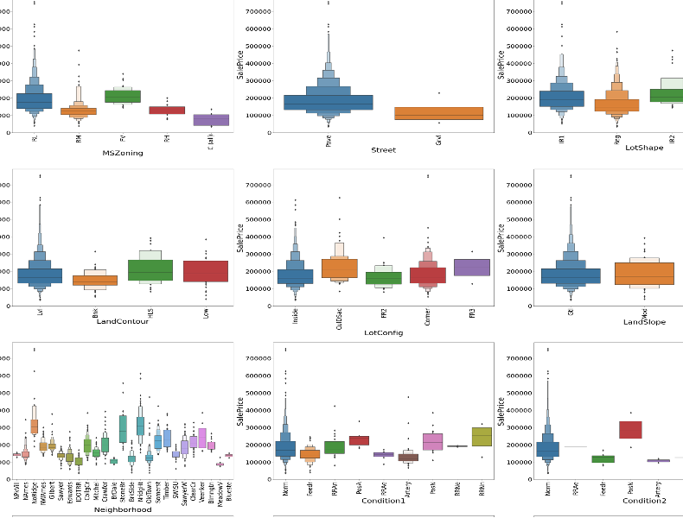
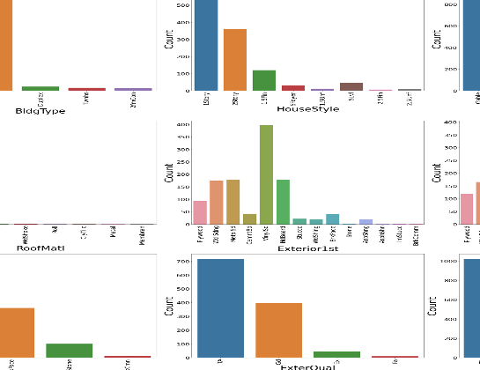
Visualization of Categorical columns
REAL ESTATE LISTING － JANUARY 2020

Slide 13
Observations:
The Price and demand is highest for Residential Low density Zone property.
Paved roads are preferred more and of higher price.
Slightly Irregular Lot shape is having higher Price and range than regular Lot shape which is preferred by more customers.
Northridge and Northridge Heights neighborhoods are having higher prices.
Normal proximity to various conditions is costlier than any others.
1 Family detached dwelling is in more demand and costlier than any other types.
2 Storey houses are costlier.
Hip roof style is more expensive.
Poured concrete Foundation is very expensive than slab which is cheapest.
For Standard Circuit Breakers & Romex (Sbrkr) of Electrical system (Electrical) the SalePrice is Maximum.
For Completely finished (Fin) Interior of the garage(Garage Finish) the SalePrice is high.
For Home just constructed and sold (New) and Contract 15% Down payment regular terms(Con) of type of sale(Sale Type) has highest SalePrice.
For Home was not completed when last assessed (associated with New Homes) (Partial) Condition of sale (Sales Condition) the SalePrice is maximum.
REAL ESTATE LISTING － JANUARY 2020

Slide 14

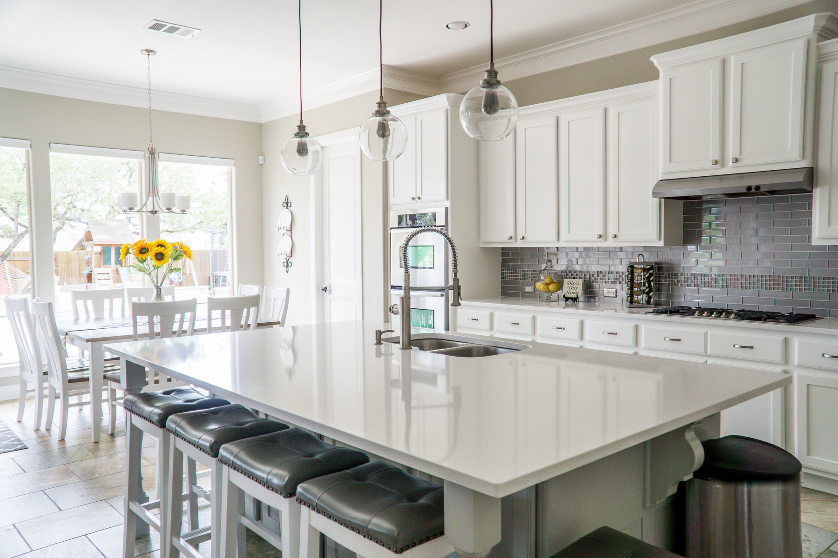
ANALYSIS
I Have used barplots to visualize the count of Categorical
I have used distplot to analyze distribution of numerical
I have used a boxen plot to find the relation between categorical and target.
I have used swarmplot, strip plot and scatter plot for visualization of numerical columns with target.

Slide 15

Data Cleaning Steps
In my datasets I found null values, outliers and skewness and removed them.
I have used imputation method to replace null values. To remove outliers, I have used percentile method. And to remove skewness I have used Yeo-Johnson method.
To encode the categorical columns, I have use Ordinal Encoding.
I have used Pearson’s correlation coefficient to check the correlation between dependent and independent features.
I have used standardization and also checked Multicollinearity and dropped columns.
Next step was model building with all regression algorithms.

Slide 16
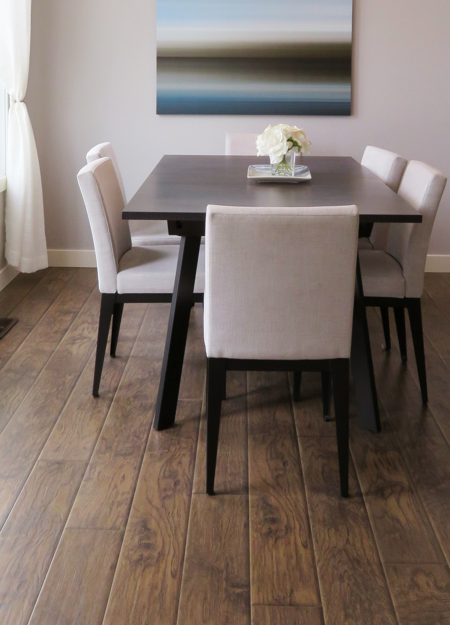
MODEL BUILDING
Since our Target is SalePrice which is continuous, I have a Regression Problem. I have used 5 different algorithms to build the models and found the R2 score and CV Score of each one of them. I have finally decided to select the model which has the least difference between R2 and CV Score and that model is Random Forest Regressor model.
I have Used:
Linear Regression
KNN Regressor
Random Forest Regressor
XGB Regressor
Gradient Boosting Regressor.

Slide 17

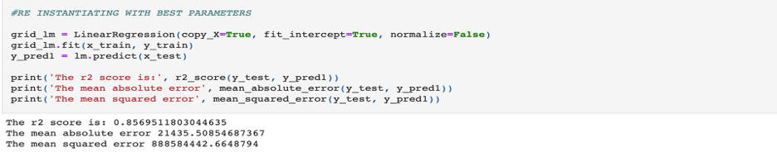
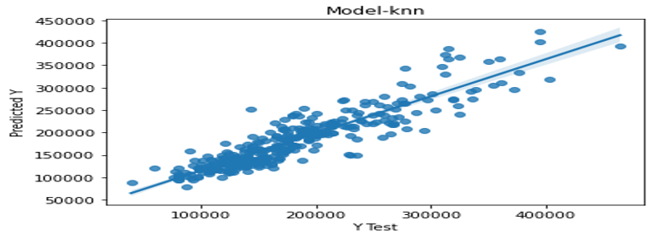
Linear Regression:
At first, I found the best Random state for which I got the best score and performed a train-test-split to fit the model. My score for Linear regression model is 85.69% and CV Score of 79.97%. I have tuned with the best parameters, but score remained the same.
KNN Regressor:
I found the best random state which yields the best score and then fit the model. R2 score for KNN Regressor was 82.75% and CV Score of 73.43%. I have tuned with different parameters, but the score has not improved. The regplot of actual and predicted values using KNN is:

Slide 18

XGB Regressor:
The R2 score of XGB Regressor was 88.92% and CV Score of 83.30%. Score did not improve after Hyper parameter tuning.
Gradient Boosting Regressor:
TThe r2 score of Gradient boosting was the highest among all other models which is 90.78%. But the CV score was comparatively low, and the difference is more than my best model. CV Score of GBR is 83.14%.

Slide 19
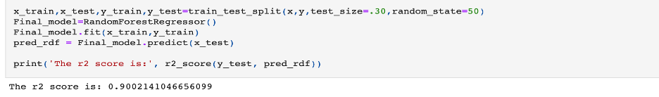
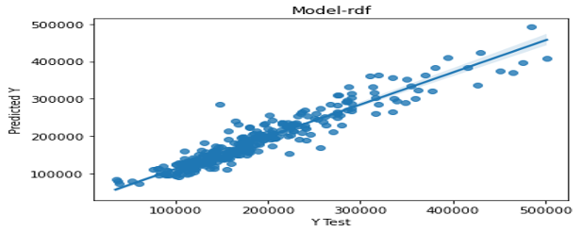
Random Forest Regressor:
I first found the best random state and fit the model. I got a score of 89.89% and a CV Score of 83.92%. Hence, I selected the random forest as the best model and saved the model. While performing the fitting of the final model, my score was improved, and it became 90.02%. Hyper parameter tuning of the model did not increase my score.
The regplot of actual VS Predicted for
Random Forest model shows it’s a good model.
The CV Score

Slide 20

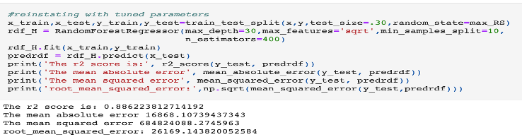
Hyper Parameter Tuning
Hyper parameter tuning of the model did not increase my score.

Slide 21

Saving the Model
I have saved my best model using .pkl as follows.
After saving the best model, loading my saved model and predicting the test values.

Slide 22
CONCLUSIONS:
In this project report, I have used machine learning algorithms to predict the house prices.
I calculated the performance of each model using different performance metrics and compared them based on these metrics. I have also saved the data frame of predicted prices of the test dataset.
I have used the r2 score as the accuracy score of the model.
I have used mean squared error, mean absolute error to find the error rate in the model.
I have used root mean squared error and took the least amount as the best fit model.
I also used Cross Validation Score to cross verify with r2 score and find the best model which has the least difference between r2 score and cv Score mean.
I have observed that certain features like OverallCond, ExterQual, etc contribute the most to the Price of the house.
Conditions like years since built negatively affect the price. As years passed the value decreased.
This study is an exploratory attempt to use five machine learning algorithms in estimating housing prices, and then compare their results.
There was a lot of skewness present in the dataset which will again affect the model as we must transform it.
I had to use the Percentile method and it is not as effective as the Z-score method in removing outliers.
There were a few columns with more values as 0 and a few with more missing values. I must remove those columns.
Multicollinearity was present and I had to remove most correlated column to remove multicollinearity.
Even after all these Limitations and drawbacks, my model tends to perform well with an accuracy of 90.02% with Random Forest model and a CV Score of 83.92%.
REAL ESTATE LISTING － JANUARY 2020

Slide 23
THANK YOU

